Slide 1
PTP – A Simple yet Powerful Way to Synchronize Ethernet-Based Cameras
Nikolaus Kerö, Oregano Systems
Erich Maurer, Oregano Systems
Tobias Müller, Oregano Systems

Slide 2
Introduction
Common notion of time is crucial for almost all applications
Ethernet has become the only viable communication medium
  Performance is highly customizable
  Bandwidth, fault tolerance, latency, costs, availability, ….
One single communication medium both for and time
  R.I.P. Legacy time transfer and sync systems
Ethernet is asynchronous
  Time transfer has to be packet based
PTP – Precision Time Protocol

Slide 3
Precision Time Protocol
PTP – Precision Time Protocol
  IEEE1588 Standard
  Generic protocol for highly accurate time transfer over Ethernet
  Customizable via PTP-Profiles
Adopted as the only means of clock synchronization by various industries
  Telecom
  Power Utility Providers
  Finance Service Providers
  Broadcasting
  GigE Vision
Accurate time transfer has become mission critical

Slide 4
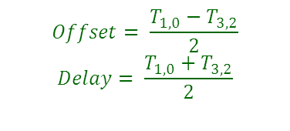
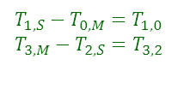
Basic Principles of PTP
Master
Master
Time
Slave
Time
Sync message
12:00
12:00
Offset_{M,S}
T_{0,M}
Slave 1
T₁,_{S}
$T_{1,S}−T_{0,M}=T_{1,0}$
$$T_{3,M}−T_{2,S}=T_{3,2}$$
Slave 2
T₂,_{S}
Slave n
$$Offset= \frac{T_{1,0}−T_{3,2}}{2}$$
$$Delay= \frac{T_{1,0}+T_{3,2}}{2}$$
T₃,_{M}
Master
Delay Response
T₃,_{S}
Slave
Delay Request
Slave n

Slide 5
Fault Tolerance in PTP
BMCA – Best Master Clock Algorithm
Based on PTP Announce messages
  Every Master Advertises its clock quality
Trigger Conditions
  Timeout (Absence of Announce Messages)
  Content … A better (more accurate) Master joins the network
Eventually the best Master will always take over
Extremely robust solution providing partial fault tolerance

Slide 6
Accuracy in PTP
Node dependent
  Time stamping resolution
  Oscillator quality
Network related
  Packet Delay Variations
  Performance of PTP aware network devices
  Different paths upstream and downstream
  Highly asymmetric network loading
Configuration dependent
  Message rates

Slide 7
PTP Boundary Clock
PTP Boundary Clock
Master
Master I
Slave I
Listen I
BC
L1
S2
M2
BC
S1
L2
L1
BMCA for all ports
M3
M3
L3
M4
Mn
M4
Mn
L4
Ln
Slave II
Slave II
Listen II
Slave IV
Slave IV
Listen IV
Slave III
BC 2
Slave III
Listen III

Slide 8
PTP Aware Network Topology
Network devices
  Standard datacenter products with line rate capabilities
  Built-in hardware PTP support (Boundary Clocks)
40G
40G
40G
BC
BC
BC
BC
Leaf
Spine
Leaf
Leaf
1G
Auxilliary Master
Grandmaster
Slave
1G
1 PPS
1 PPS
Out-of-Band Measurement

Slide 9
Offset between Master and Slave

Slide 10
Filtered Offset viewed from the Slave

Slide 11
Application Requirements
Multi camera image analysis
  Time Labels for every frame
  Precise point in time for drawing time stamps
Highly synchronized frame capturing
  Generation of arbitrary frequencies
  Extremely high resolution
  User definable phase offset
External synchronization
  V-Sync signal from master camera

Slide 12
PTP Clock Architecture Digital PLL

Slide 13
Digital High Resolution Frequency Generation

Slide 14
How to Generate Phase Locked Arbitrary Signals
Period [kHz] | 15 | 30 | 70
 | Resolution=2e-16ns
1 ns Error after | 4.4 | 2.2 | 0.9 | Seconds
 | Resolution=2e-32ns
1 ns Error after | 79.5 | 39.8 | 17.0 | Hours
 | Resolution=2e-48ns
1 ns Error after | 610 | 305 | 131 | Years

Slide 15
How to Generate Phase Locked Arbitrary Signals

Slide 16
Conclusions
PTP is perfectly suited for synchronizing multiple cameras
  Robust
  minimal configuration
  Well proven IEEE Standard
Accuracy
  Sub-µs accuracies achievable with standard network devices
  sub 10ns within PTP networks
Versatile Signal Generation
  Frame Syncs
  Time Labels

Slide 17
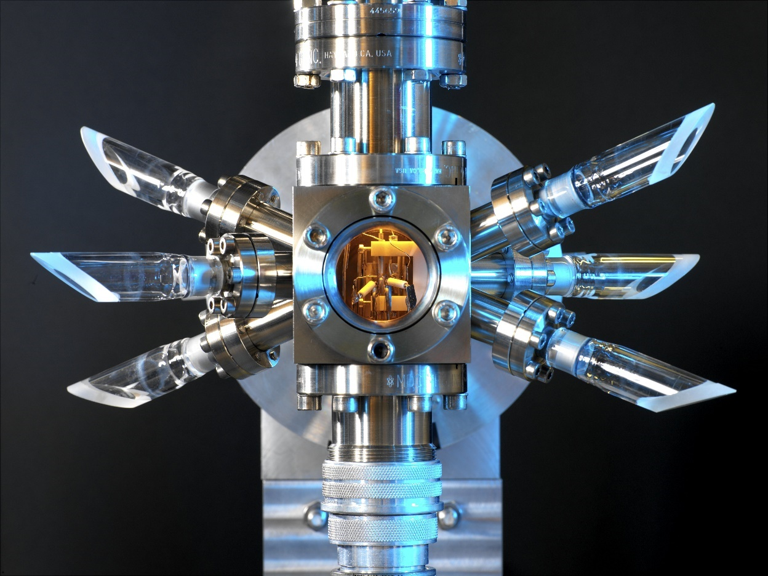

Thank You for Your Attention
Strontium-ion optical clock at NPL UK - 100ns deviation per 100 years

Slide 18
Backup Slides

Slide 19

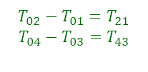
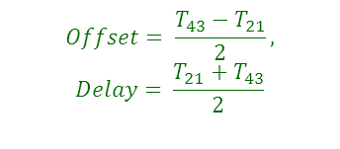
Extended Monitoring
Master
Slave
Monitoring
System
Slave
12:00
12:00
12:00
T₀₁
12:00
Del_Req + TLV
Sync
T₀₂
$T_{02}−T_{01}=T_{21}$
$$T_{04}−T_{03}=T_{43}$$
Del_Req
Del_Resp + TLV
Del_Resp
T₀₃
$$Offset= \frac{T_{43}−T_{21}}{2},$$
$$Delay= \frac{T_{21}+T_{43}}{2}$$
Sync
T₀₄

Slide 20
Rationale
PTP – Precision Time Protocol
  IEEE1588 Standard
  Generic protocol for highly accurate time transfer over Ethernet
  Customizable via PTP-Profiles
Adopted as the only means of clock synchronization by various industries
  Telecom
  Power Utility Providers
  Finance Service Providers
  Industrial automation
  Broadcasting
Accurate time transfer has become mission critical

Slide 21
Accuracy in PTP
Node dependent
  Time stamping resolution
  Oscillator quality
Network related
  Packet Delay Variations
  Performance of PTP aware network devices
  Different paths upstream and downstream
  Highly asymmetric network loading
Configuration dependent
  Message rates

Slide 22
Extended Data Processing
Even extended filtering can mitigate PDV effects significantly
  Dynamic outlier detection
  Servo optimization
  Lucky Packet Algorithm
However
  Sudden PDV changes/increases may affect accuracy permanently
Use data of more than 1 Master

Slide 23
Use data of more than 1 Master (I)
How to implemented within PTP?
  Different domains
  Unicast
Enhancements at the Slaves
  Independent protocol engines for every Master
  Extended data processing …
Advantages
  Cope with deteriorations of the signal path
  Discard faulty Masters
  Handle Byzantine faults

Slide 24
Use data of more than 1 Master (II)
How to combine time information of more than one Master
  Simple linear combination (mean value) insufficient
  Permanent deteriorations only damped
  Byzantine faults still effect accuracy
Solution
  Outlier detection at front end
  Kalman filter to combine data of multiple Masters
  Servo

Slide 25
Simulation of two Different Masters

Slide 26
Simulation of two Different Masters

Slide 27
Combining Data From 3 Different Masters

Slide 28
Combining Data From 3 Different Masters

